Slide 1

Fundraising: Honoring the Past,
Funding the Future
DEVOTIONAL
Theme: The Journey
Where We've Been • Where We Are • Where We're Going
Notes:
Welcome and frame the session as a devotional on fundraising. Set the tone: this is not about chasing dollars, it is about stewarding a shared journey. Introduce the controlling metaphor — The Journey — and the three movements we'll travel together: where we've been, where we are, and where we're going. Invite people to hold both gratitude for the past and hope for the future as we begin.

Slide 2
OPENING DEVOTION
“In their hearts humans plan their course,
but the Lord establishes their steps.”
Proverbs 16:9
Lord, as we honor the past and fund the future, establish each step of our journey.
Notes:
Open with a moment of devotion before we get into the work. Read Proverbs 16:9 aloud and pause: we make plans, set goals, and chart routes — yet it is the Lord who establishes our steps. Invite the group to hold their fundraising work as stewardship, not striving. We plan faithfully and trust humbly. Offer the short prayer on the slide, asking God to honor what has been built and to guide what comes next, then transition into the journey ahead.

Slide 3
YOUR TRAVEL ITINERARY
Workshop Outcomes
By the end of our trip together, you'll be able to:
01
02
03
Connect to Mission & Legacy
Map the Donor Journey
Build a 90-Day Route Plan
Tie every ask to why the past matters, so giving feels like joining a story far bigger than any single gift.
See how supporters move from first contact to long-term partnership — and where to meet them at each step.
Leave with a practical, near-term plan you can act on right away, not a binder that sits on a shelf.
02 / 16
Notes:
Lay out the itinerary so people know where we're headed. Outcome 1 grounds fundraising in mission and legacy — the past is fuel, not nostalgia. Outcome 2 introduces the donor journey as a map we can actually navigate. Outcome 3 promises something tangible: a 90-day route plan with owners and dates. Emphasize that this is a working session — they'll leave with a plan, not just ideas.

Slide 4
THE BIG METAPHOR
Fundraising is a journey, not a transaction.
1
Donors are travelers
They're joining a shared story and want to see where it leads — not simply completing a payment.
2
Our role is to guide
We light the way, remove friction, and celebrate milestones so the whole trip feels worth taking.
3
Structure carries momentum
Every journey needs a map, checkpoints, and a destination.
A clear map, honest checkpoints, and a real destination keep supporters moving forward with confidence.
03 / 16
Notes:
This metaphor is the spine of the whole workshop. Donors aren't ATMs — they are travelers choosing to walk with us. Reframe the development office's job from 'extracting gifts' to 'guiding a journey': we provide the map, mark the checkpoints, and celebrate progress. Stress the third point — structure. Generosity rarely fails for lack of heart; it fails for lack of a clear path. Everything that follows fills in that map.

Slide 5

WHERE WE'VE BEEN
Honoring the Past
Moments that built trust
Recall the decisions and people who first earned credibility for this mission and made others believe.
Foundational supporters & early wins
Name the donors, volunteers, and milestones that proved what was possible when few were watching.
Traditions worth carrying forward
Identify the values and practices that should travel with us into the next chapter of the story.
04 / 16
Notes:
Begin where every good journey begins — by looking back with gratitude. Walk through the moments that built credibility: the risk someone took early, the first major gift, the program that worked. Name names where you can; specificity honors people. The point isn't sentimentality — it's to surface the traditions and values worth carrying forward. Ask the room: what from our history must never be lost as we grow?

Slide 6
LEGACY → MOMENTUM
Why the Past Fuels the Future
THEN
NOW
NEXT
Recognition builds belonging
→
Impact stories earn trust
→
Continuity across generations
Honoring history strengthens confidence and a sense of belonging in supporters today.
Proven stories of change make future investment feel safe, credible, and worthwhile.
“Then → Now → Next” carries momentum from one generation of givers to the next.
05 / 16
Notes:
Show how legacy converts into momentum across three movements. THEN: recognizing past supporters strengthens belonging — people give more freely where they feel they belong. NOW: documented impact builds the trust that de-risks the next gift. NEXT: the 'Then → Now → Next' rhythm hands continuity from one generation of givers to the next. The throughline: the past isn't behind us, it's the fuel propelling us forward.

Slide 7
WHAT WE'VE LEARNED
Lessons From the Road
Three questions to mine our own history before we plan ahead.
?
?
?
What has motivated supporters to give?
Which messages performed best?
What stewardship should we protect?
Look back at the appeals, causes, and moments that consistently moved people from interest to action.
Notice the themes and stories that earned the strongest response — then repeat what already works.
Pin down the thank-you and reporting habits worth defending, repeating, and never letting slip.
06 / 16
Notes:
Turn history into instruction. Ask the room these three questions honestly. First, what has actually motivated giving here — relief, belonging, rescue, pride? Second, which messages landed best — and are we still using them? Third, which stewardship practices earned loyalty that we must protect even as we scale. The goal is to repeat what works and stop reinventing the wheel each campaign.

Slide 8
WHERE WE ARE
Where We Are Now
Donors expect clarity & ease
Today's supporters want transparency and a giving experience that's simple, fast, and frictionless.
Retention requires stewardship
Keeping donors takes intentional, ongoing care — not simply sending more and louder asks.
THE OPPORTUNITY
Shift from transactional to relational fundraising.
07 / 16
Notes:
Locate us honestly on the map today. Donor expectations have shifted: people want clarity, transparency, and giving that takes seconds, not minutes. Retention is now won through stewardship, not volume of asks — chasing new gifts while leaking existing donors is a losing game. Land the opportunity hard: the move from transactional to relational fundraising. We're standing at a crossroads, and the relational road is the one that compounds.

Slide 9
ROUTE OVERVIEW
The Donor Journey Map
1
2
3
4
Awareness
Consideration
Conversion
Retention
They first discover the mission and what's at stake.
They weigh whether to trust us and give.
They make their first, defining gift.
They stay, give again, and deepen support.
Define what donors need at each stage — then find where they stall or drop off, and why.
08 / 16
Notes:
This is the donor's-eye view of the route: Awareness, Consideration, Conversion, Retention. At each stage donors have different needs — information when aware, reassurance when considering, an easy path when converting, and recognition when retained. The strategic work is two-fold: define what donors need at each stage, and diagnose where they stall or drop off. Most organizations lose people in the gap between Awareness and Conversion — find your leak.

Slide 10
NAVIGATION SYSTEM
The Donor Cycle
1
2
3
4
5
Identification
Qualification
Cultivation
Solicitation
Stewardship
Build discipline
Stewardship is the bridge
Move donors forward intentionally at every step — never leave progress to chance.
It's what turns a first gift into repeat and increased giving over time.
09 / 16
Notes:
If the journey map is the donor's view, the donor cycle is our internal navigation system: Identification, Qualification, Cultivation, Solicitation, Stewardship. The discipline is in deliberately moving people from one stage to the next rather than hoping they advance on their own. Note that the cycle ends — and restarts — at Stewardship, highlighted here in teal. Stewardship is the bridge from a single gift to repeat and upgraded giving; skip it and the cycle breaks.

Slide 11

THE FUEL
Storytelling Moves People
One person + one problem + one transformation
Make the donor the hero
“You made this possible” will always outperform “look at the great work we did.”
Pair emotion with clarity
Combine a story that moves the heart with a clear, concrete picture of what their funding does next.
10 / 16
Notes:
Story is the fuel that moves the whole journey. Keep the formula simple: one person (or one community) + one problem + one transformation. Resist the urge to cram in statistics and program names. Crucially, cast the donor as the hero — 'you made this possible' — not the organization. Then pair that emotion with clarity: after the heart is moved, show exactly what the next gift will fund. Emotion opens the door; clarity walks them through it.

Slide 12
CHOOSE YOUR VEHICLES
Funding the Future
A
Annual giving
Broad participation — the wide base of everyday supporters.
B
Recurring giving
Stability and predictability you can count on month to month.
C
Major gifts
Acceleration — transformational gifts that move the needle fast.
D
Grants & corporate partners
Strategic lanes that fund specific priorities and programs.
E
Planned & legacy giving
Long-horizon impact that extends generosity beyond a lifetime.
11 / 16
Notes:
Funding the future means choosing the right mix of vehicles — no single lane wins alone. Annual giving builds the broad base and pipeline. Recurring giving delivers predictable, compounding stability. Major gifts provide acceleration and transformation. Grants and corporate partners open strategic lanes for specific priorities. Planned and legacy giving extends impact over the long horizon. The goal isn't to pick one — it's to balance the portfolio so today's stability funds tomorrow's growth.

Slide 13
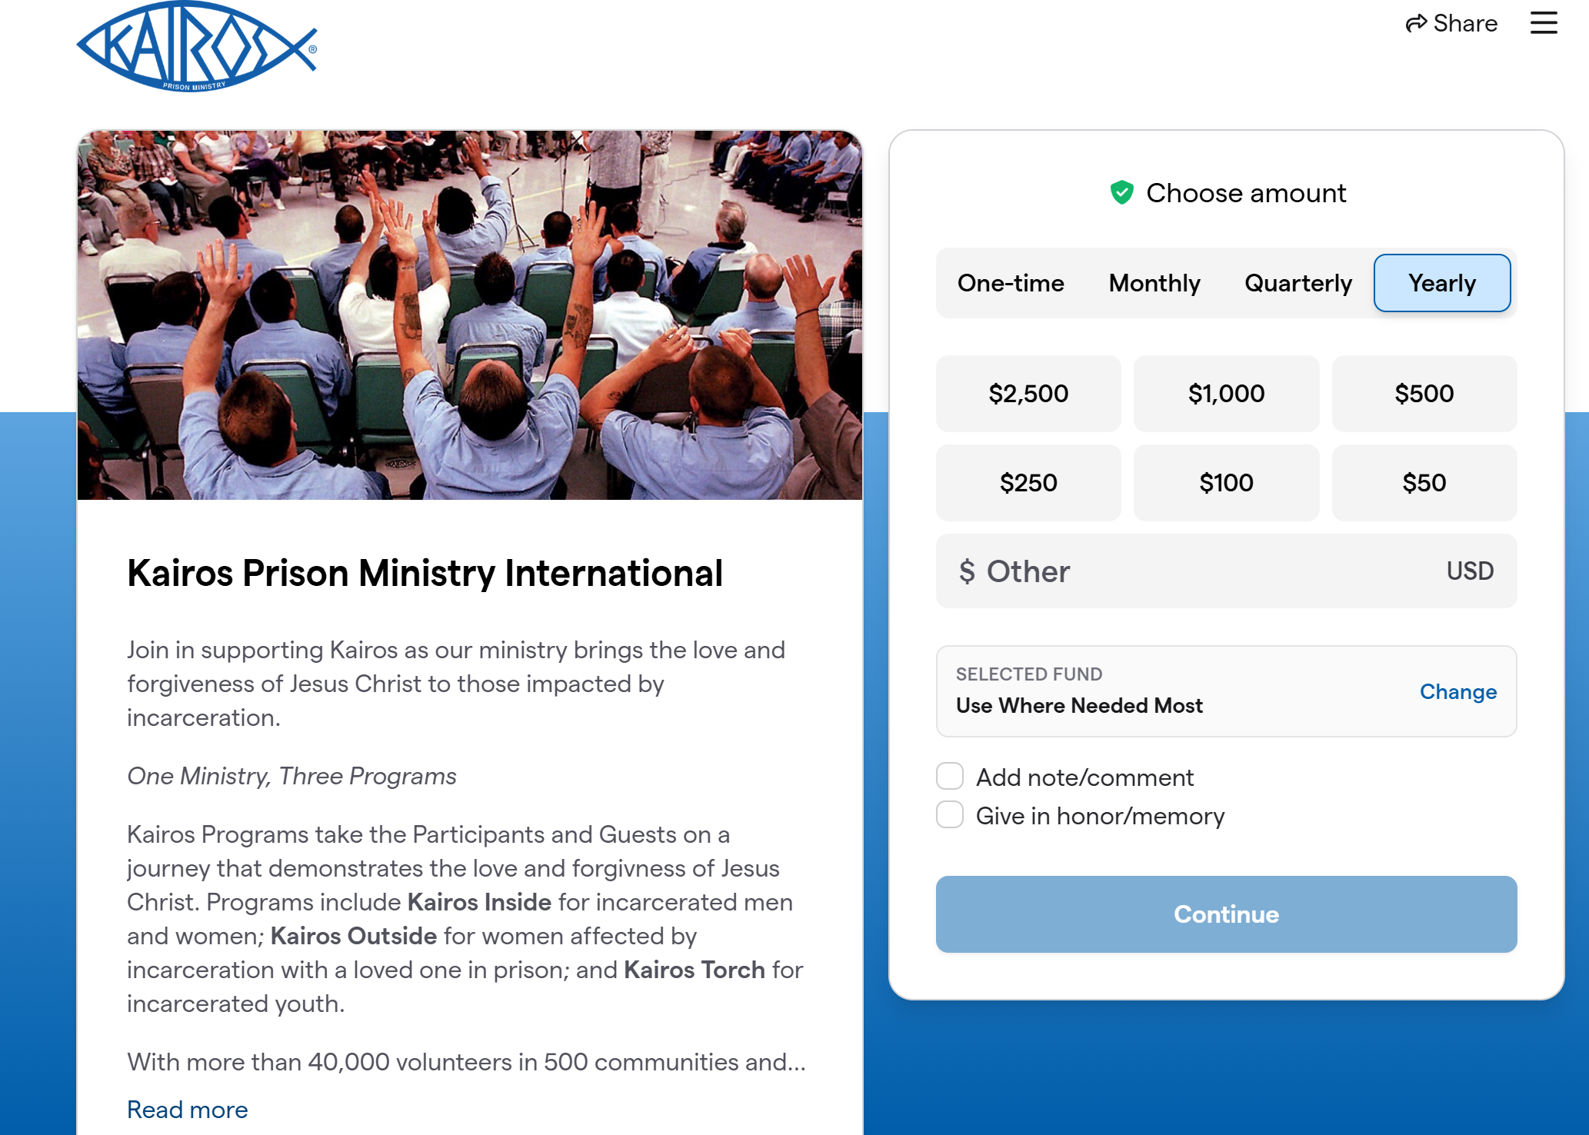
CHOOSE YOUR VEHICLES
www.KPMI.org
One-Time
Recurring Giving
Planned Giving
https://givebutter.com/kairosprisonministry
11 / 16
Notes:
Funding the future means choosing the right mix of vehicles — no single lane wins alone. Annual giving builds the broad base and pipeline. Recurring giving delivers predictable, compounding stability. Major gifts provide acceleration and transformation. Grants and corporate partners open strategic lanes for specific priorities. Planned and legacy giving extends impact over the long horizon. The goal isn't to pick one — it's to balance the portfolio so today's stability funds tomorrow's growth.

Slide 14
DESTINATION + MILESTONES
The Campaign as an Expedition
1
Define the destination
Describe what success actually funds — the changed reality — not just a dollar number on a thermometer.
2
Break goals into checkpoints
Turn the distant summit into milestone stages the team can see, reach, and celebrate along the way.
3
Assign owners, tools & timelines
Give every checkpoint a named owner, a clear method, and a real date so nothing drifts.
12 / 16
Notes:
Frame the campaign as an expedition, not a fundraising number. First, define the destination in human terms — what does success make possible? People summit for a view, not for a figure. Second, break the climb into milestone checkpoints so the team experiences progress instead of one distant peak. Third, assign every checkpoint an owner, a tool, and a timeline. A goal without an owner and a date is just a wish.

Slide 15
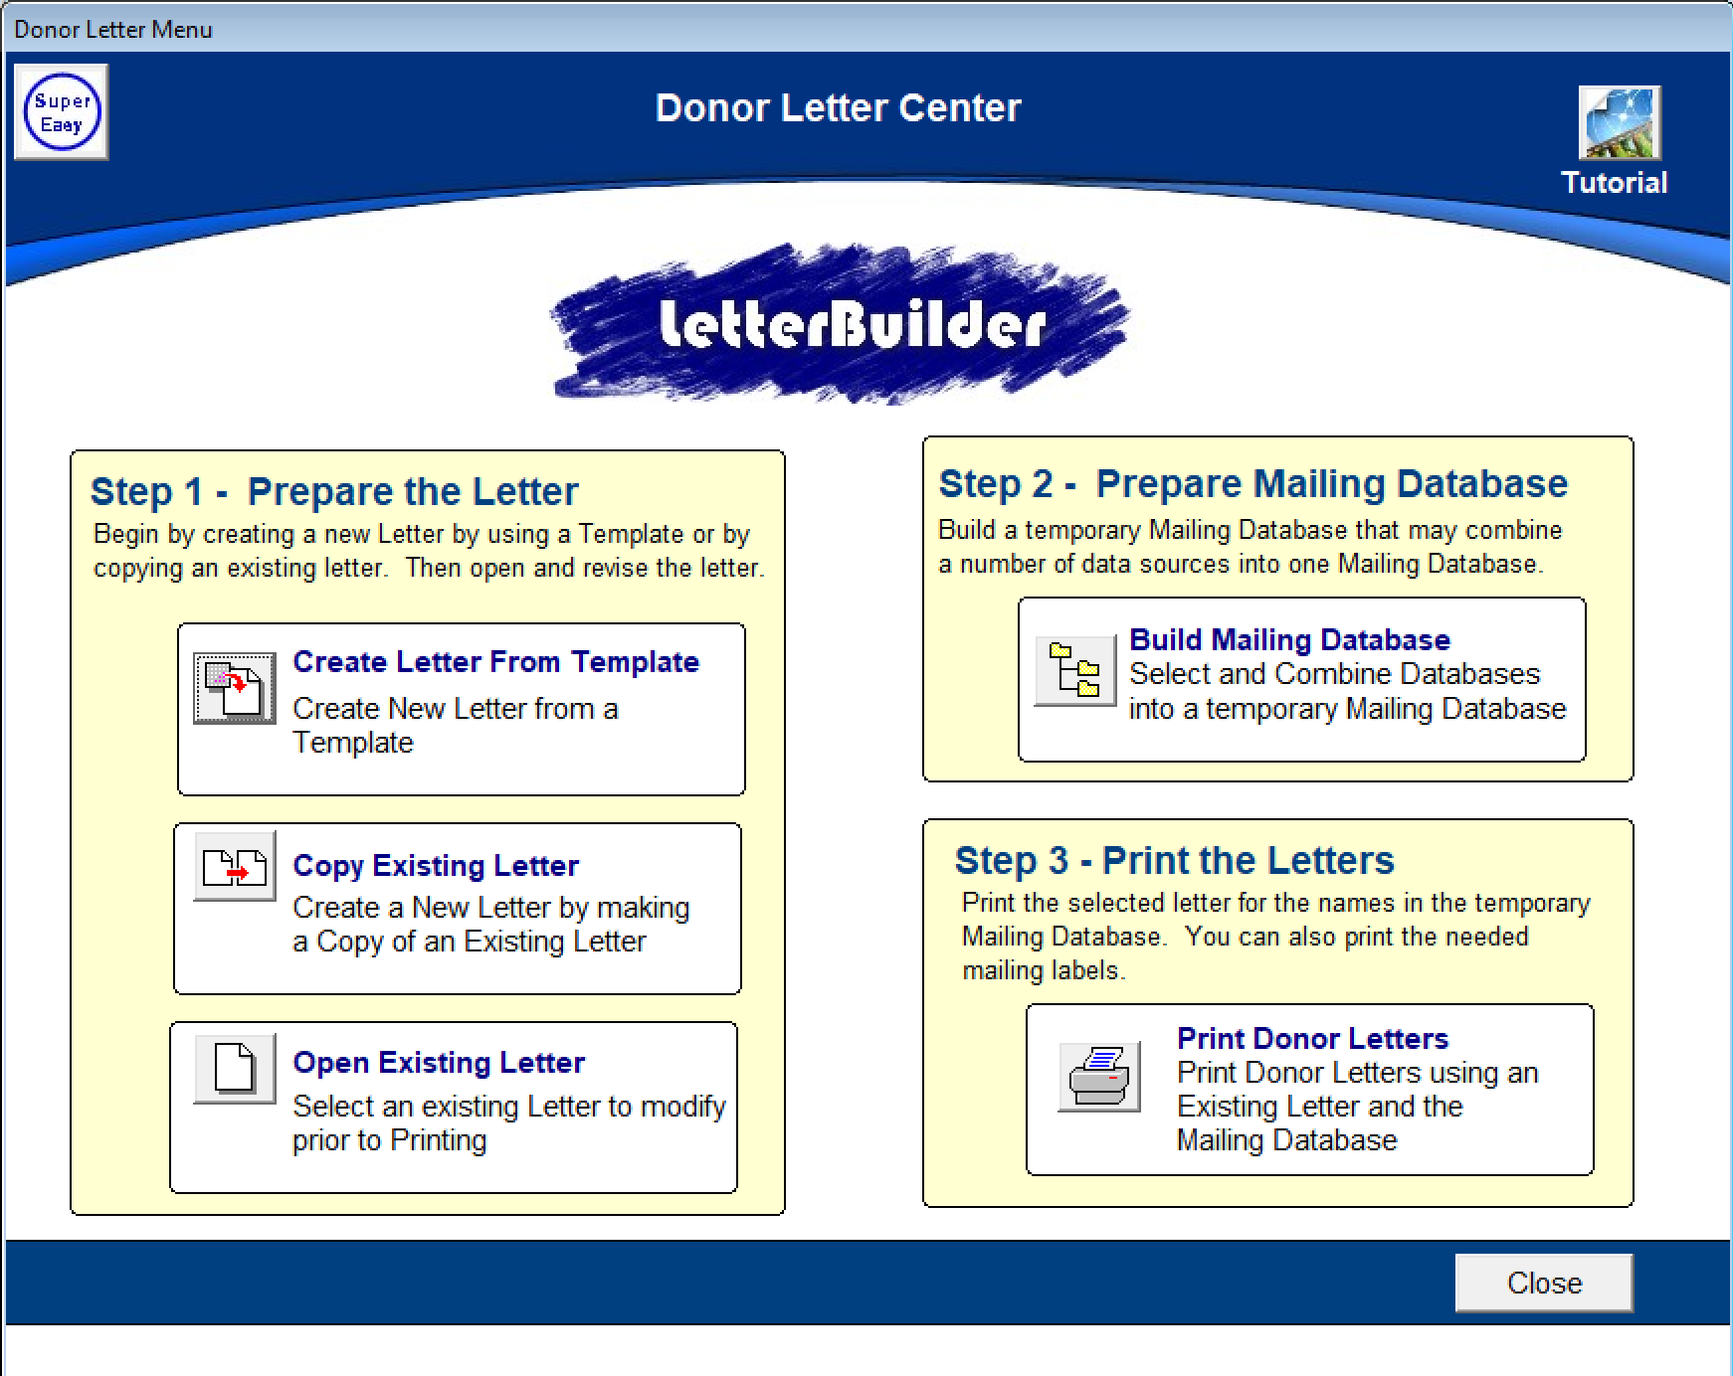
Kairos Donor Software
Donor Letter Tutorial
Build Mailing Database
Create/Edit Letter per Campaign
  Upcoming Weekend
  Annual Donor
  Corporate Donor
  Recurring Donor (monthly via GiveButter)
  Planned Giving (estate planning)
Print the Letter

Slide 16
RETENTION + UPGRADE
Stewardship: The Return Trip
The journey doesn't end at the gift — it loops home and sets up the next trip.
1
2
3
Thank quickly & personally
Report impact consistently
Recognize in ways that honor legacy
Fast, clear, human gratitude within days sets the tone for every interaction that follows.
Show what changed because of the gift — again and again — so donors see their footprints on the trail.
Celebrate support so it both honors the past and inspires the next, larger gift.
13 / 16
Notes:
Stewardship is the return trip that makes the next journey possible. Three non-negotiables. Thank quickly, clearly, and personally — speed and warmth matter more than polish. Report impact consistently so donors can see what their gift actually changed; vague gratitude erodes trust. And recognize support in ways that honor legacy and invite the next, larger gift. Done well, stewardship turns one-time travelers into lifelong companions.

Slide 17
HOW WE KNOW WE'RE ON TRACK
Metrics Are Our GPS
Acquisition
Retention
Recurring growth
Upgrades
New donors gained — is the top of the journey filling?
Donors who stay and give again — are we keeping travelers?
Sustainers added — is predictable income rising?
Donors giving more — are relationships deepening?
Celebrate milestone wins — momentum is built one recognized victory at a time.
14 / 16
Notes:
Metrics are our GPS — they tell us whether we're still on the route. Track four signals: acquisition (is the top of the journey filling?), retention (are we keeping the travelers we have?), recurring growth (is predictable income rising?), and upgrades (are relationships deepening into larger gifts?). Then do the human thing the data can't: celebrate milestone wins out loud. Recognized progress is what keeps a team and a donor base moving.

Slide 18
EXERCISE
Build Your Donor Journey
1
Choose one donor type
New, lapsed, recurring, or a major prospect.
2
Map the four journey stages
Awareness → Consideration → Conversion → Retention, with one touchpoint per stage.
3
Share one “next best step”
Name the single most valuable action that moves your donor forward right now.
15 / 16
Notes:
Now they build. Give roughly ten minutes. Step 1: each person or table picks one donor type — new, lapsed, recurring, or a major prospect (the most strategic and overlooked). Step 2: map the four journey stages and commit to just one concrete touchpoint per stage — keep it realistic. Step 3: identify a single 'next best step' to move that donor forward this week. Then have a few share. The constraint of one touchpoint per stage is intentional — it forces focus over wish-lists.

Slide 19

Commitments:
The Next 90 Days
YOUR ROUTE PLAN
1
Honor the past — One legacy or recognition action.
2
Improve the journey — One donor touchpoint upgrade.
3
Fund the future — One campaign or funding-mix move.
Name owners, dates, and a first step for each action.
16 / 16
Notes:
Close by turning insight into commitment for the next 90 days. Ask each person to leave with three actions: one to honor the past (a legacy or recognition move), one to improve the donor journey (a single touchpoint upgrade), and one to fund the future (a campaign or funding-mix move). The discipline that makes it real: name an owner, a date, and a first step for each. End on the image — the road ahead is open, and we travel it together. Honor the past, fund the future.

